Slide 1
Technology in ADR: Computers as Mediators
Just when you thought it was safe to go into the water … What are the implications for barristers?
By
Robert Angyal SC
6 St James

Slide 2
Just when you thought it was safe to go into the water …
So, you’ve realised that trial work is becoming drastically truncated.
You’ve re-focused your practice on mediation – in acting as a mediator, and as an advocate at mediation, and acquired the needed skills.

Slide 3
Just when you thought it was safe to go into the water …
Just when you were getting comfortable in these unfamiliar roles and polishing your revised resume, you hear that a bunch of silicon chips and zeroes and ones are about to make you redundant.
How should you respond?

Slide 4
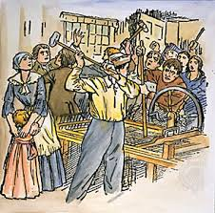
Should you take a Luddite approach and smash the machines?

Slide 5
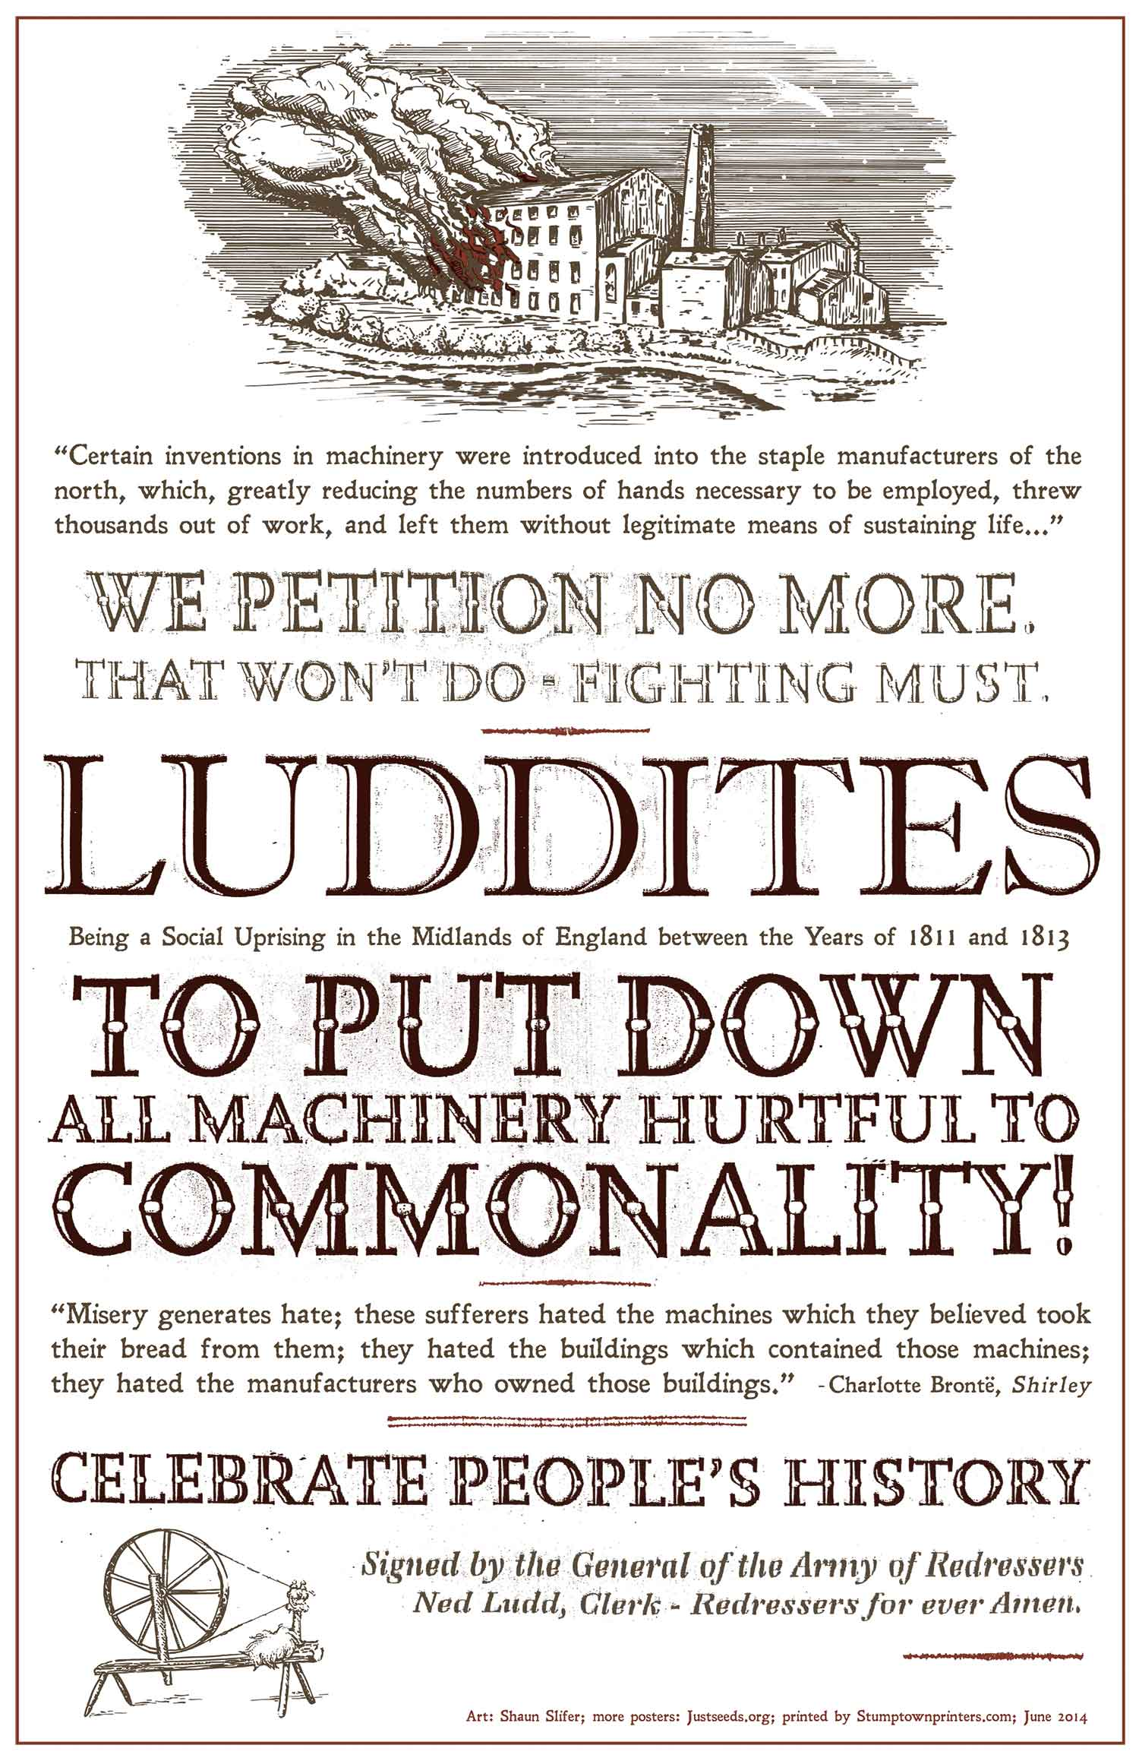
“Certain inventions in machinery …”
“Certain inventions in machinery were introduced into the staple manufacturers of the north, which greatly reduced the number of hands necessary to be employed, threw thousands out of work, and left them without legitimate means of sustaining life… .”

Slide 6
First Response: Smash the Machines
The instinctive response is, metaphorically, to smash the machines, e.g.:
“It’ll never work.” [But it does.]
“Computers don’t have the emotional intelligence to be mediators/advocates at mediation.” [Many people say this about barristers.]

Slide 7
First Response: Smash the Machines
“Mediation requires the human touch.” [Tell that to Lee SE-dol, the world champion in the board game Go (the most complex board game ever devised), after being walloped by a programme designed by Google Deep Mind in March this year. “I am very surprised because I have never thought I would lose.”] http://nyti.ms/1R6IyRu
“Government regulation will protect us from disruption by the Internet.” [Tell that to the taxi drivers.]

Slide 8
Second Response: No Threat to My Market
OK, you’re not going to try to smash the machines. Instead, you’re going to marginalise them so that they’re not a threat.
At least for now, you say, online mediation seems to be focussing on disputes and disputants who wouldn’t have retained lawyers anyway.

Slide 9
Second Response: No Threat to My Market
That’s because either (1) the dispute is too small to warrant hiring lawyers and/or (2) the disputants can’t afford to hire lawyers.
So online dispute resolution is filling a gap in the legal services market that currently is not adequately served by providing legal services where, previously, none would have been provided.
So it’s a good thing (1) because of this and (2) because it’s no threat to my market

Slide 10
Second Response: No Threat to My Market
Not so fast!
It is only a matter of time before online dispute resolution becomes sophisticated enough to take on the big end of town in dispute resolution.
So much for the Second Response. What then?

Slide 11
Third Response: Differentiate Yourself
The third response is to analyse mediation and mediation advocacy in search of skills that a computer does not have but you do have.
In other words, you must differentiate yourself from a computer.

Slide 12
Third Response: Differentiate Yourself
A computer can effortlessly tell you how many times “res ipsa loquitur” appears in the Commonwealth Law Reports.
A computer can effortlessly tell you how many times McTiernan J said “I concur.”
There is no point trying to compete with this.

Slide 13
Third Response: Differentiate Yourself
Where you can compete is by providing skills that a computer cannot master.
What are these skills?
Examples (as a mediator):
Devising lateral solutions.
Crafting an apology.
Anticipating and avoiding impasses.
Audience suggestions, please.

Slide 14
Third Response: Differentiate Yourself
More examples (as a mediation advocate):
Advising your client in a mediation whether an offer made to them is better than their BATNA.
Devising lateral solutions.
Crafting an apology.

Slide 15
Third Response: Differentiate Yourself
More examples (as a mediation advocate):
Anticipating and diffusing the impact on your client of the “end game” of mediation.
Audience suggestions, please

Slide 16
CONCLUSION
Online dispute resolution is likely to become a threat to you as a mediator and as a mediation advocate.
There is no point trying to smash the machines or to compete on their turf.
There is very considerable potential for competing by differentiating your skills.
Go forth and differentiate!

